Slide 1
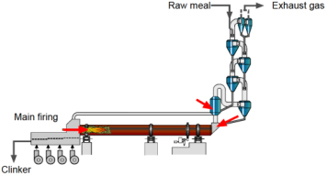
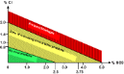
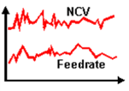

AFR Co-processing
CO
Cl
TSR
SPREAD Course 2016, Settat, Sorin Petrescu - Geocycle

Slide 2
Learning Objectives
Understand why AFR causes challenges in the kiln process
Thermal energy consumption
Kiln production rate
Kiln availability
Get to know the major process optimization measures and kiln system modifications to master these challenges
Kiln OEE

Slide 3
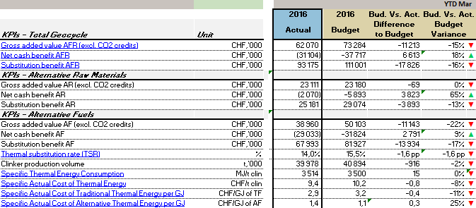
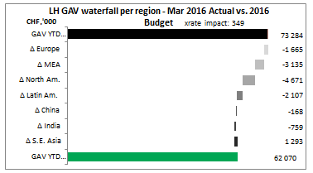
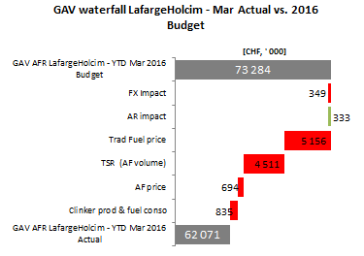
AFR results to date
What is the LH %TSR by end March 2016?
Are we ahead or behind the Budget?
What is the average cost of GJ? (overall and AF)
What about financial results (GAV)?

Slide 4

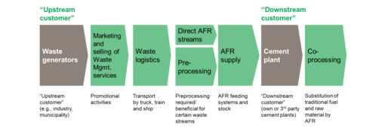
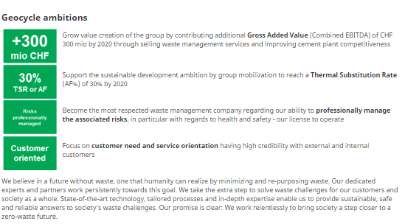
Geocycle at a glance

Slide 5
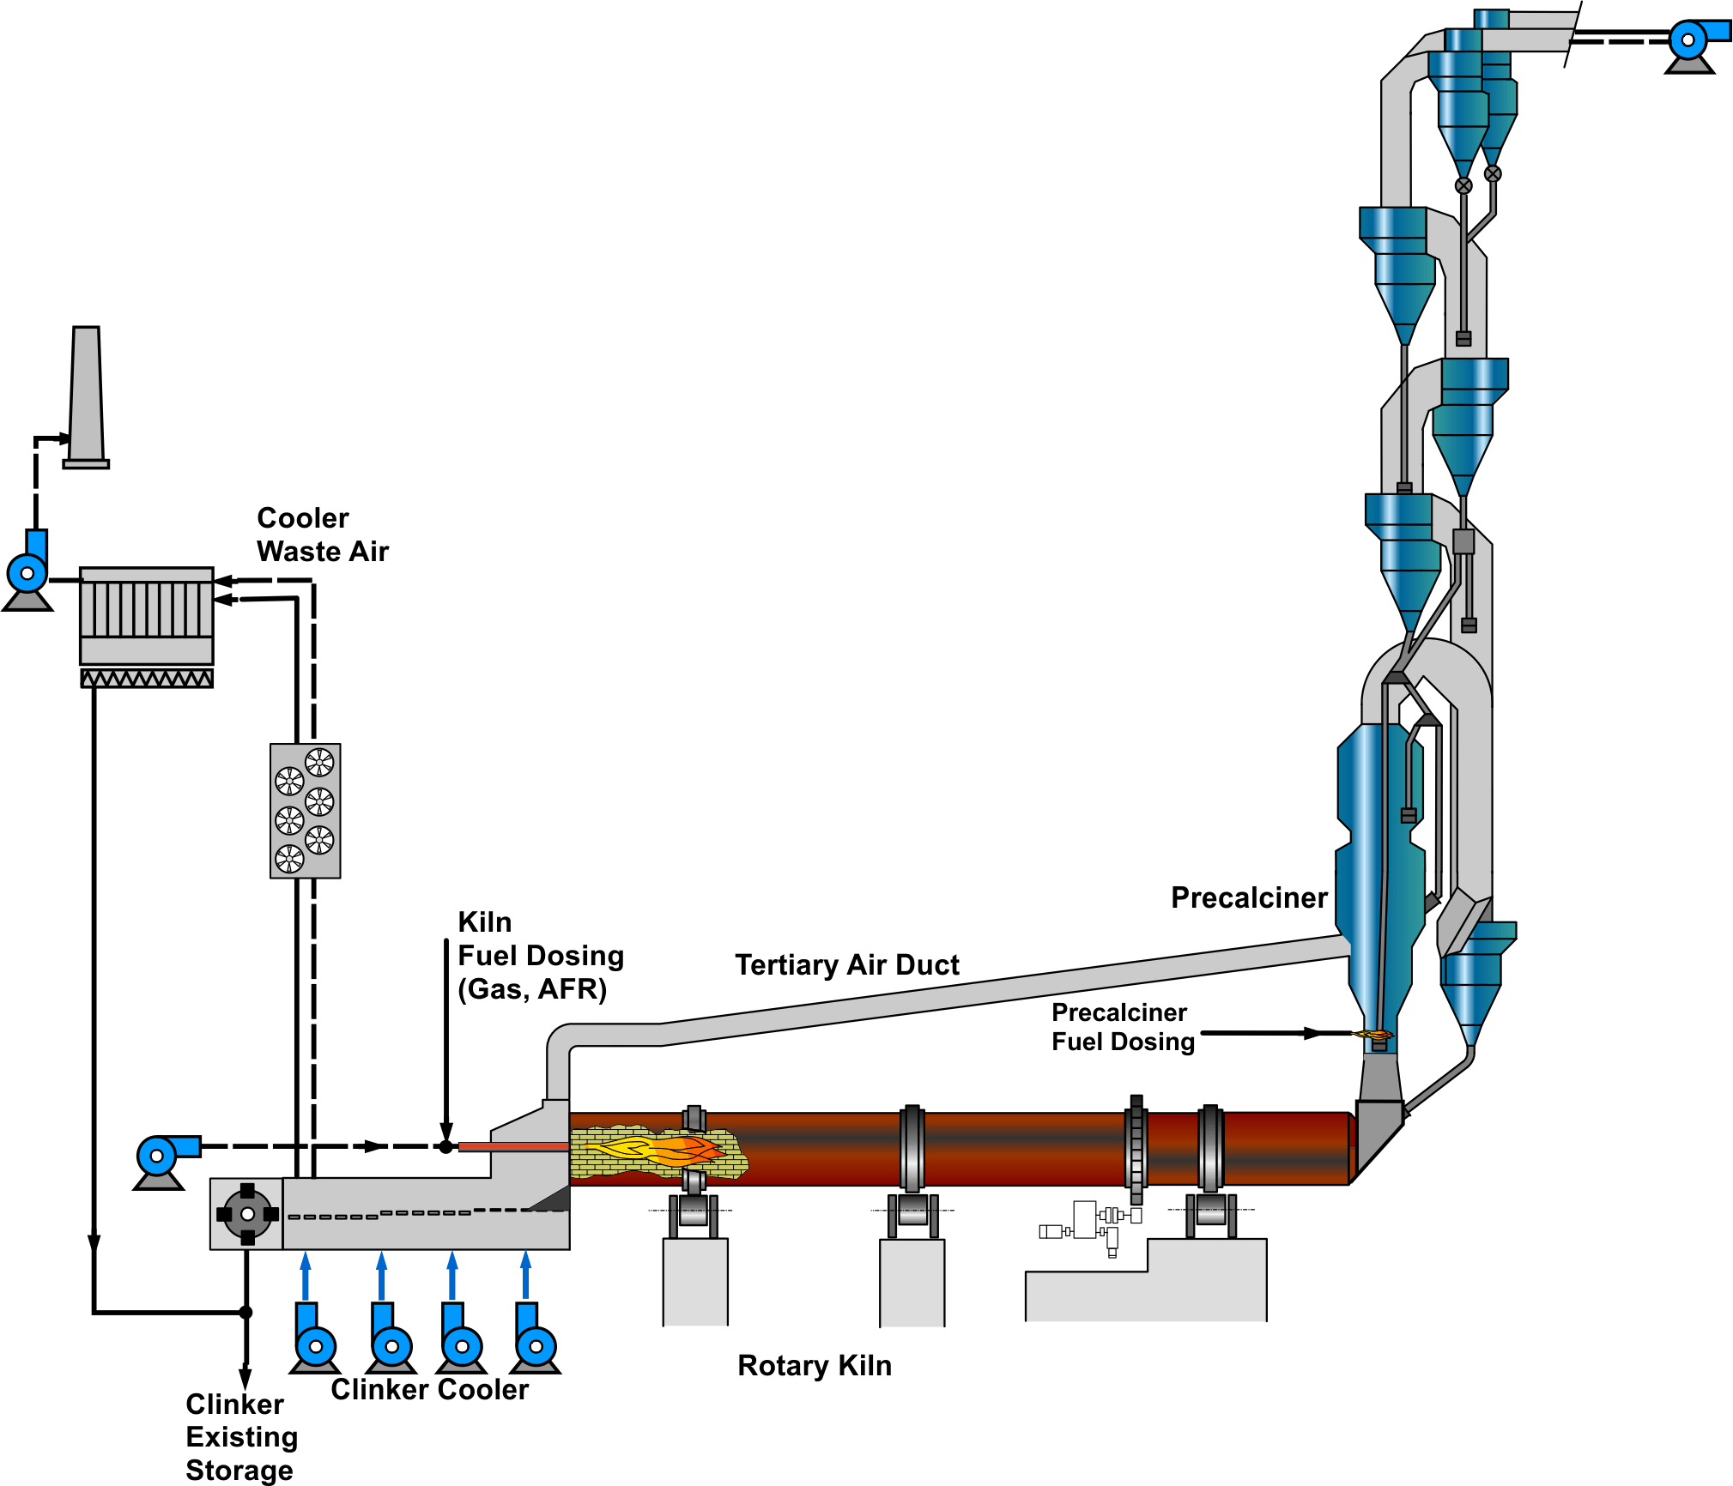
AFR doesn’t make life easier, but certainly more interesting
Challenges
Kiln Process (Co-Processing)
Consequence
Solutions to avoid impacts on OEE, Quality and Emissions
Increased Heat Consumption
More difficult Fuel Properties
Higher Exhaust Gas Volume Higher Input of Chlorine
Reduced Kiln OEE
Deterioration of Quality
Higher Emissions

Slide 6
Content
AFR fuel categories and feed-points
Problematic AFR properties and kiln impacts
Optimizations / modifications to mitigate AFR impacts
Kiln
Precalciner/preheater
Exhaust gas handling system
Checklist for AFR assessment (co-processing focus) and main findings
Challenges and Solutions in kiln operation

Slide 7
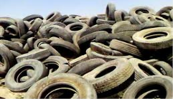
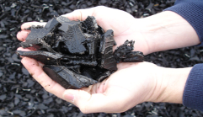
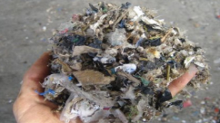


The right Degree of Fuel Preparation for each Feed Point
AF Category | Characteristic | Examples | Picture
Lump fuels 3D solids >50mm 2D foils >200mm | Cannot be carried by kiln gases (burns at kiln inlet). | Whole tires, filter cakes, bagged material
Coarse solids 3D solids <50mm 2D foils <200mm | Can be carried by kiln gases (suitable for in-line calciner). Pneumatic feeding not possible. | Tire chips, shredded plastics and textiles, RDF_{c}
Fine solids 3D solids <5mm 2D foils <50mm | Can be carried easily by kiln gases (suitable for kiln firing, separate-line calciner). Pneumatic feeding possible. | Fluff (RDF_{f}), impregnated saw dust, animal meal, rice husk
Sludges | Pumpable with piston pump → lump fuel. If atomized by compressed air or sludge rotor → coarse solid. | Petroleum / paint sludges
Liquids | Can be atomized with compressed air (solid particles in liquid <2-4mm) | Waste oil, solvents, emulsions

Slide 8
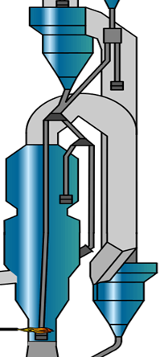
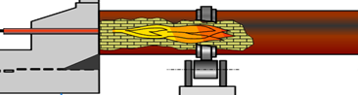
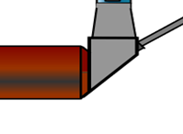
Feed-point specific combustion behavior and issues with solid AF
Fine solids: big calciner required for burn-out (5 s gas residence time) if not: CO, heat losses,..
Fine solids: → oversize materials create issues with coating, clinker quality and S-volatility (build-ups)
Lump solids: fall down, poor mixing with O2 → slow combustion, build-ups → low TSR potential
Coarse solids: suspended in gas stream (35-45 m/s) → good mixing
Notes:
Additional question: why is it no good to use fine solid AF in riser duct of kiln without precalciner?

Slide 9
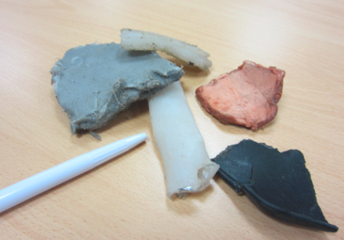
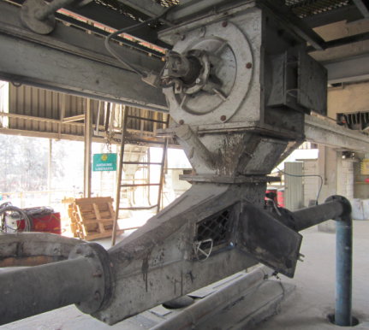
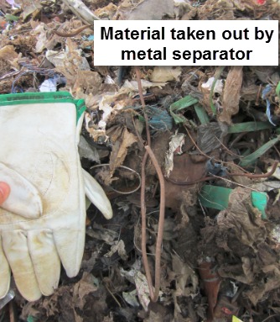
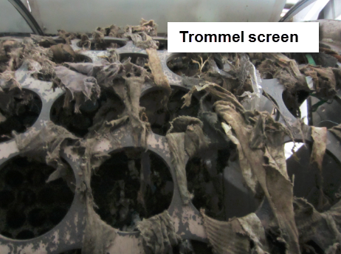
Large and heavy particles are critical and may prevent further increase of TSR at main burner
Example: Particles found in fluff of Lägerdorf plant → problems with BZ coating stability and S-volatility
Why does it block frequently at the injector?

Slide 10
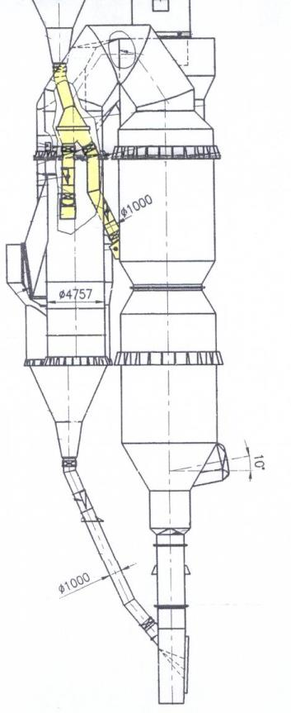
Calciner: The best place to burn AFR
The PC is superior to burn (coarse) AFR:
Up to 60% of heat input in PC
Lower temperature required (lower CV materials possible)
Less sensitive to heat input fluctuations than burning zone
Flameless combustion
Tertiary air with 21% O2
Meal staging for temp. control (hot spot)
Solid AFR
up to 40 m/s

Slide 11
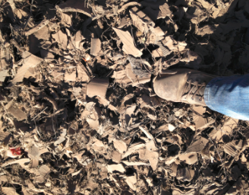
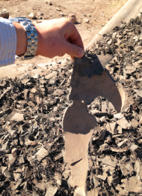
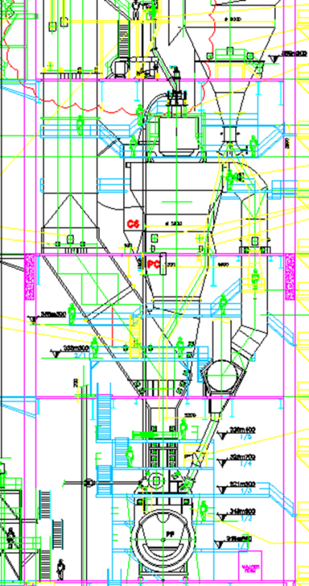
Why no significant fall through, even though only 26 m/s calciner orifice velocity (recommended ~35-40 m/s)?
Tire chips are too coarse but not so thick.
Very long orifice (sufficient time) decelerates falling tire chips. Furthermore the tire chips will already be reduced in size and partly burnt in pre-combustion chamber.
tire chips

Slide 12
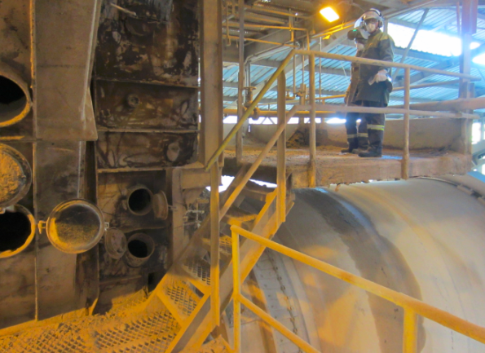
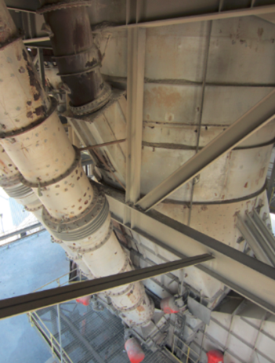
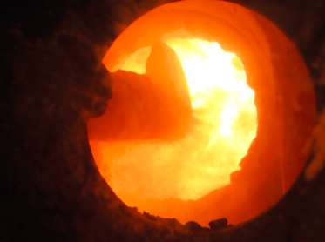
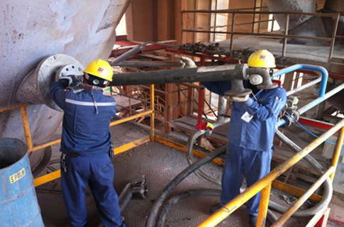
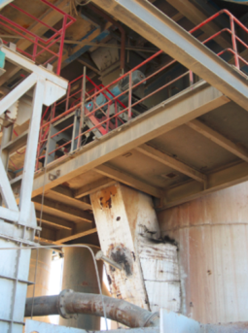
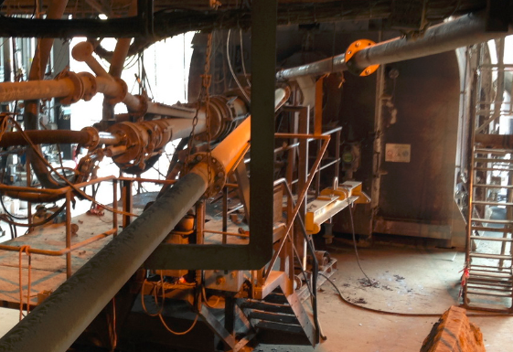
Feed Point Examples
sludge riser duct
solids precalciner
fine solids
kiln burner
sludge precalciner

Slide 13
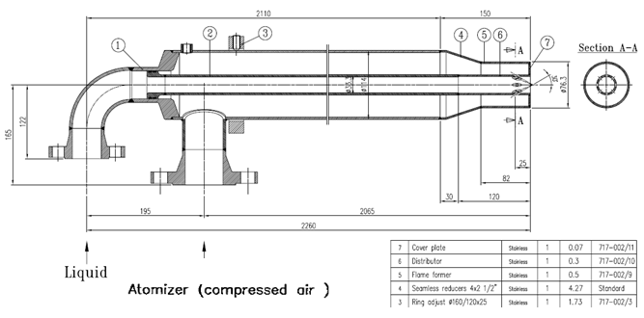
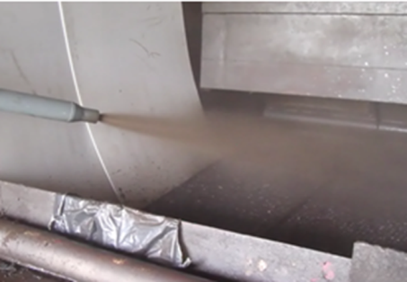
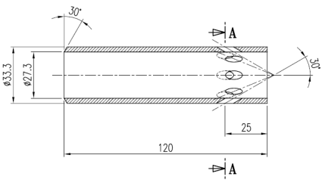
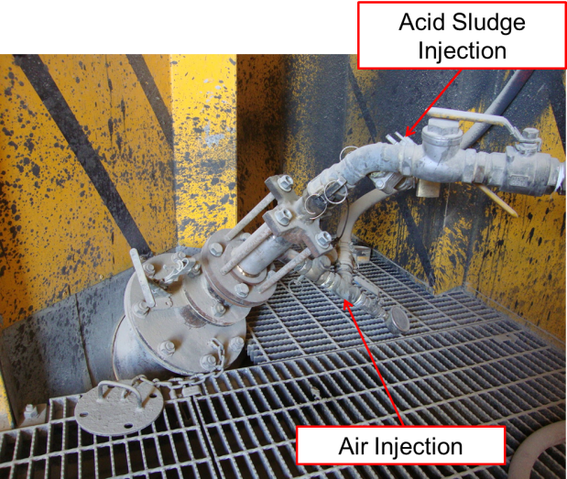
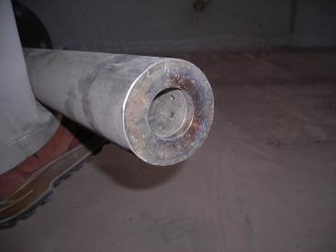
Pneumatic sludge atomization (up to 5’000-10’000 cP, ~ viscosity of molasses)

Slide 14
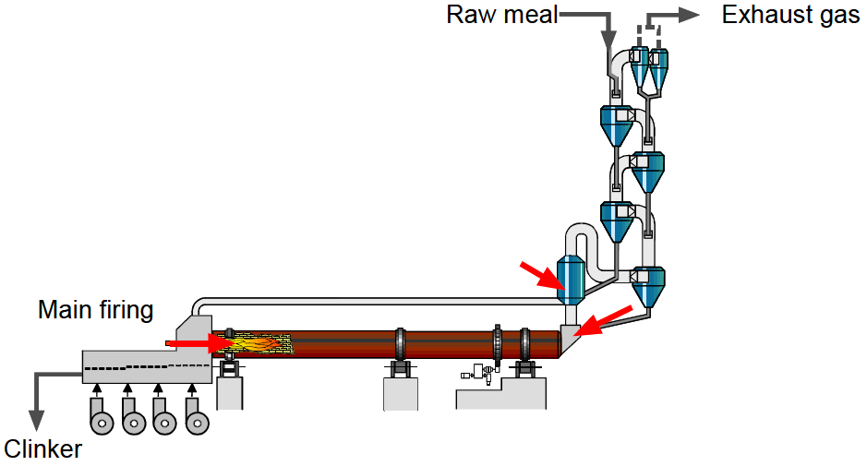
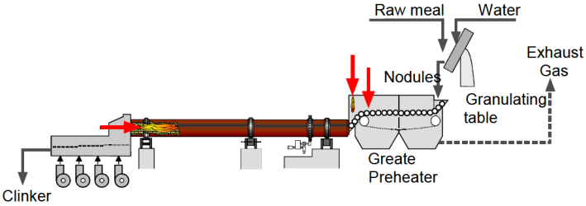
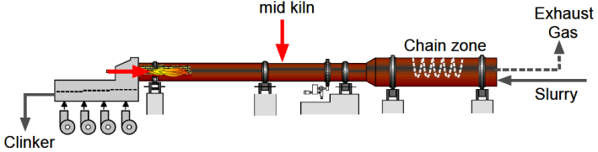
Calciner is the preferred feed-point! → highest TSR potential & can burn coarse solids
Liquids
All feed points
Suspension preheater kiln (SP/PC)
Main firing
Fine solids
Calciner firing fine solids coarse solids sludges (atomized)
Calciner firing
Kiln inlet firing
Alternative fuel
Coarse solids
Calciner firing (not SLC)
Kiln firing fine solids
atomized
Calciner firing
Sludges
Secondary firing (kiln inlet, riser duct) lump fuels, coarse solids, sludges
not atomized
Kiln inlet firing
Kiln feed
Short kiln
Kiln inlet firing
Emissions !
Lump fuels
Long kiln
Mid-kiln firing
Grate preheater kiln (Lepol)
Long kiln (wet/dry)
Secondary firing only liquids recommended
Secondary firing (mid kiln) lump fuels, coarse solids
Kiln firing fine solids
Kiln firing fine solids

Slide 15
Typical TSR limits for Precalciner kiln - depending on AFR properties and consistency, dosing accuracy, calciner size...
For standard Precalciner kiln (60% of fuel to precalciner, 40% at main burner)
Generic TSR limits given by pure combustion (if no other limits apply first e.g. Cl input, dosing fluctuations, fuel homogeneity, ash input,...)
Raw meal
Exhaust gas
Liquids | 60% TSR
Coarse Solids | 30% TSR 50-55% TSR max
Liquids | 40% TSR
Fine Solids | 15% TSR 20-30% TSR max
Main firing
Lump fuel | 5% – max 10% TSR
Clinker

Slide 16
Co-Processing of AFR in Coal Mills - Overview
AFs generally NOT suited for coal mills:
“Fiber” materials (e.g. from bio fuels) – may cause problems in separators / fineness residue control no more possible
Low melting point plastics (plastic bags, plastic mixtures) – can lead to incrustations in mill and separator
Soft plastics - can not be ground fine and may cause separator plugging
Hard ceramic materials (e.g. spent pot liners) - can not be ground very fine and lead to excessive wear
“Low temperature VOC” (e.g. Benzyls etc.) containing materials – hazardous emissions are very likely!
Mercury containing materials – hazardous emissions are very likely!
Any kind of strong smelling materials – odor emissions!
Possibly suitable materials:
Impregnated coals with non-hazardous liquids
Hard plastics
Slurries and pastes without hazardous contents
Charcoal
Some bio fuels (e.g palm kernel shells, rice husks)

Slide 17
AFs may impact coal mill emissions - Potential solutions
No critical material into coal mill (materials which may cause organic or heavy metal emissions)
Identify and characterize the origin of the sludge. Can VOC or other volatile emission be excluded by the origin of the material (i.e. if it origins from a thermal treatment)?
The sludge shall be inspected, if it smells it is likely containing volatile components leading to emissions. This could be organic materials for instance, try to characterize the smell (organic, ammonia, sulfides, etc.).
If emissions cannot be excluded one should do a test
Expulsion test at HTEC
One can measure the emissions during co-grinding by means of an external laboratory (stack testing)
Coal mill off-gas burned in kiln primary firing or kiln inlet
Use of separate mill to grind hazardous raw materials – dedusting gases burnt in primary firing

Slide 18
Co-Processing of AFR in Coal Mills - Requisites
A plant trial is believed to be the only manner to prove the ultimate co-grinding rate and the impact on the coal/coke mill
The co-grinding of AF requires a preliminary reflection on the coal shop and kiln capabilities:
A coal shop Safety Risk Assessment is completed
Mill grinding & drying capacity is available
Additional cost of co-grinding (kWh/t, wear) will be compensated by the AF savings
Co-ground AF will not reduce main burner fuel mix below 21-22 GJ/t
A fairly consistent ratio is maintained between the raw coal/petcoke and AF/biomass (mix homogeneity, dosage accuracy)
Plant personnel have good knowledge about the AF (properties, fires & explosion characteristics)
Trial is completed before decisions are made on permanent usage

Slide 19
Feed points for alternative raw materials (ARM)

Slide 20
Key messages
Calciner is the preferred feed-point
Only fine solids and liquids to the main burner
Lumpy AF to kiln inlet is limited to 5 to 10% TSR
Sludges can be prepared into different AF categories:
Impregnation with solids → fine or coarse solid
Atomization → coarse solid
Piston puming → lump solid
Coal mill is generally not suitable to co-process (co-grind) AFR
Expulsion test required for any ARM qualification

Slide 21
Content
AFR fuel categories and feed-points
Problematic AFR properties and kiln impacts
Optimizations / modifications to mitigate AFR impacts
Kiln
Precalciner/preheater
Exhaust gas handling system
Checklist for AFR assessment (co-processing focus) and main findings
Challenges and Solutions in kiln operation

Slide 22



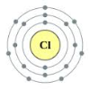
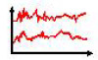
Problematic Fuel Properties for kiln operation (typically, compared to traditional fuel)
Coarser Granulometry
Higher moisture / water content
Often higher ash content (not liquids)
Lower Calorific Value (consequence of high moisture and high ash)
Higher Chlorine concentration (Sulfur typically not an issue as concentration typically ≤ traditional fuels)
Less homogeneous (e.g. standard deviation of NCV, H2O, ash,…)
Less accurate dosing and more difficult material handling (consequence of coarse granulometry and high moisture)
Which property is most critical?

Slide 23
When does it become critical? Effects in kiln system and possible remedies
Granulometry
Too coarse fuel for feed-point. Exceeding TSR per feedpoint.
CO, VOC emissions, lower NOx. Sulfur cycle / build-up formation. → higher pressure drop, more cleaning effort, cyclone blockage (availability)
Better fuel preparation (sorting, shredding) or negotiations (e.g. fluff fineness).
Moisture / water content
Very high water content and/or feed rates.
Flame cooling (lower heat transfer in kiln). Incomplete combustion (CO). Higher exhaust gas quantity and increased heat consumption. Lower NOx emissions.
Drying. Negotiations of max. water content (penalties).
Ash
Becomes relevant at ash input changes > 0.01 t ash/t clinker (depends also on ash content/composition of traditional fuel).
Raw mix needs to be adjusted. Sudden ash input changes (e.g. failure of feed system) can lead to off-spec clinker (no quick correction possible).
AF blending. Maintaining fuel mix stable (ash input).
Calorific value
At CVs below 10 GJ/t the effective fuel substitution in kiln should be checked.

Slide 24
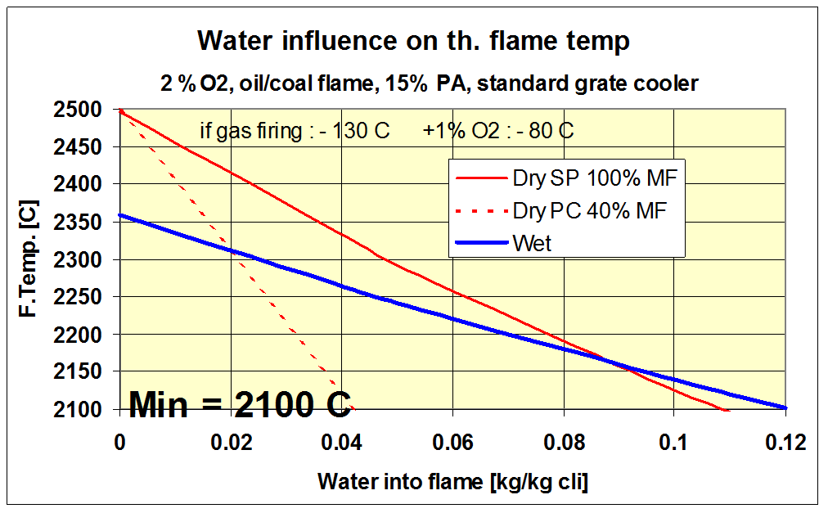
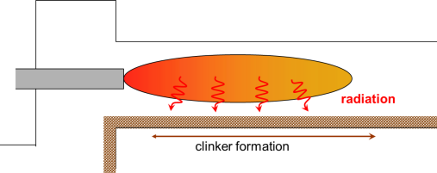
Reduced flame temperature (water, ash and too much excess air) affects BZ temperature
Consequence: weak sintering zone, clinker quality (more freelime)
The real limits may be reached before the theoretical ones
Flame Temperature Tool is developed and is available from HTEC

Slide 25
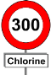
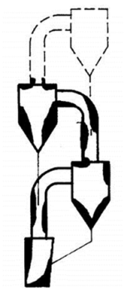
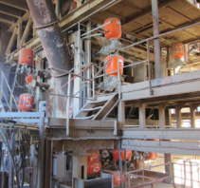
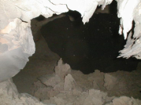
Chlorine – has it’s limits and costs
Preheater kilns are limited to 300 g Cl/t clinker input (sustainably). 50-150 g Cl/t cli typical input already from raw materials.
Cl is highly volatile and leads to fast formation of build-ups.
Installations of additional air blasters required! (100-200k EUR)
To accept higher Cl inputs, high CAPEX is required:
Gas bypass: 800-1200 g Cl/t cli (4-6 mio EUR)
Hotmeal extraction: 400-600 g/t cli (0.6-1.2 mio EUR) add. to CKD
CKD extraction: up to 400 g/t cli (0.8-1.5 mio EUR)
Example:
20% TSR, NCV 16 GJ/t AF, 1% Cl in AF, STEC 3.4 GJ/t cli
3.4 GJ/t cli * 0.2 / 16 GJ/t AF * 0.01 t Cl/t AF = 0.000425 t Cl/t clinker → * 1’000’000 = 425 g Cl/t clinker
Input limits need to be respected: Feed rates and Cl concentration
→ Max. Cl concentration to be agreed with customer and/or cost tag to Cl concentration

Slide 26
When does it become critical? Effects in kiln system and possible remedies
NCV fluctuations
Cannot be measured real time. Quick effect in calciner (°C) observable → correction of feed rate possible. Effect of NCV of BZ fuel fluctuation cannot be corrected as it is detected too late.
Cooling / overheating of kiln → process/quality (free lime) issue. CO peaks. Higher average heat consumption.
Better blending. Agreements. Actual NCV (guess) communicated to CCR.
Dosing fluctuations
High accuracy for fine solids / liquids (within seconds) required. For coarse solid feed rate stability required over a minute.
Cooling / overheating of kiln → process/quality (free lime) issue. CO peaks. Higher average heat consumption.
Maintenance. Tuning of feed rate controller. Upgrade of weighing system. New feed system.
Heat input fluctuation ± 6% → + 1% O2 required to avoid CO peaks (~ at 30% TSR)

Slide 27
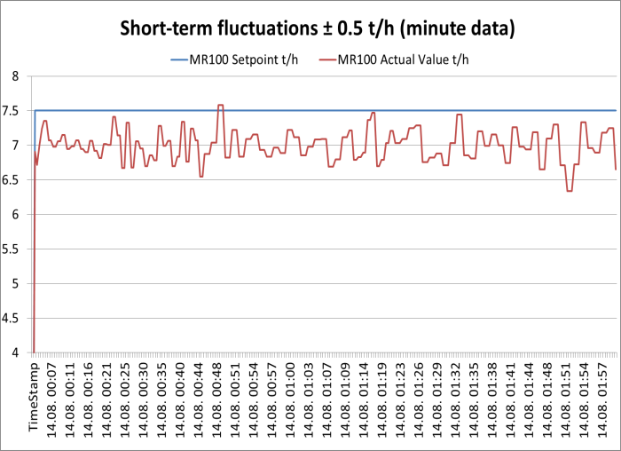
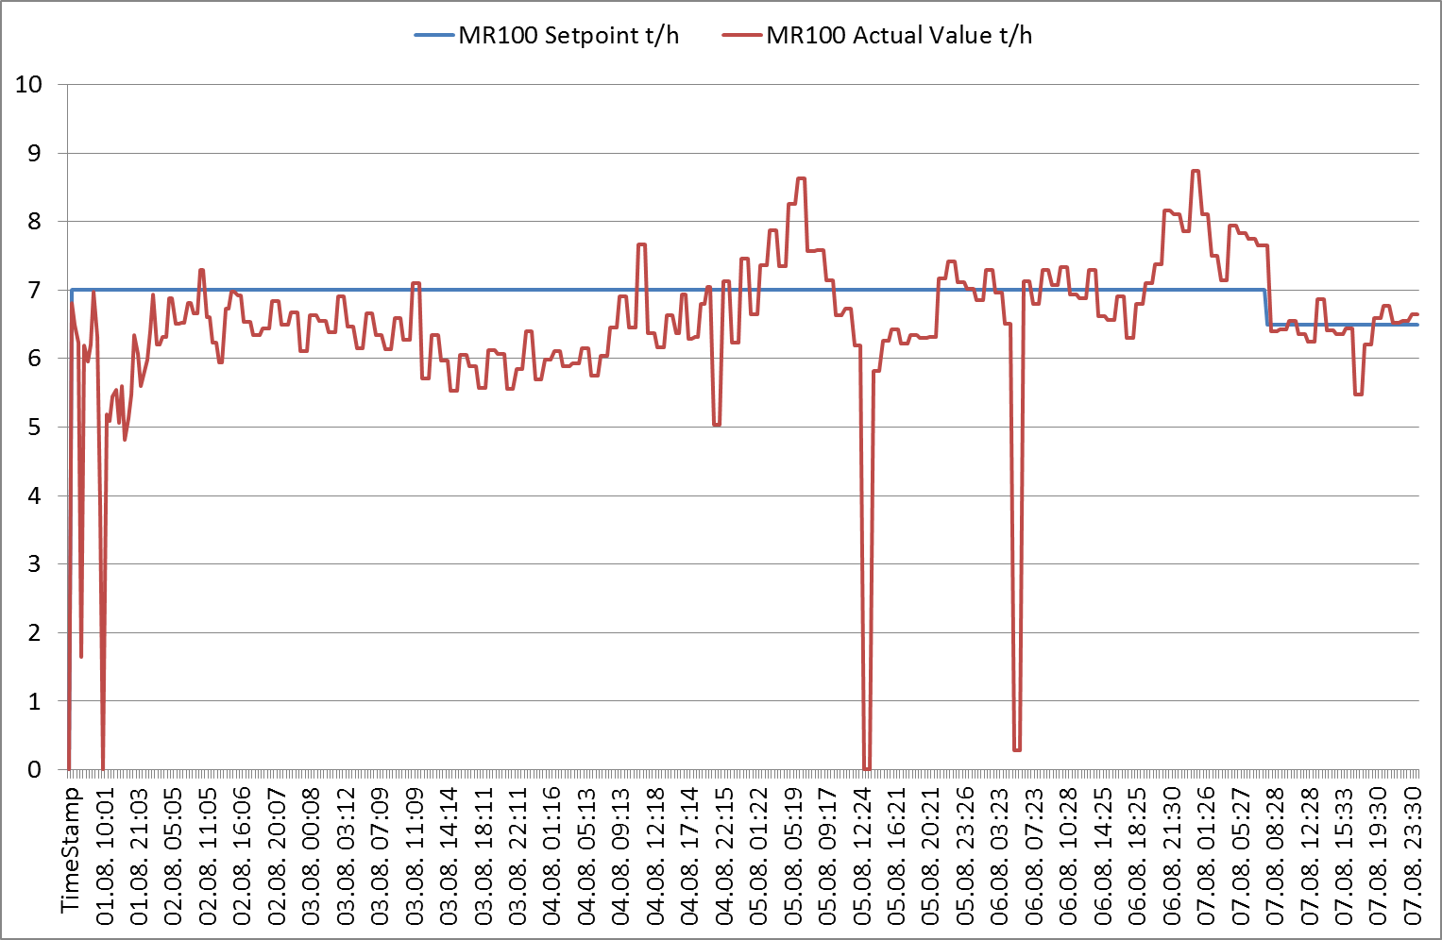
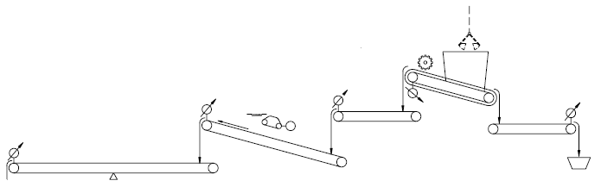
Analyze/improve dosing fluctuations and deviations from set-point!
Short-term fluctuation (minute) of ± 0.5 t/h, fluctuation 10-15%.
Significant deviations (hours) from set-point.
Correct / re-program automatic controller. Teach operators not to run in manual mode (as they will not always watch the feed rate).
Δt
Speed up intermediate belts if no VFD

Slide 28
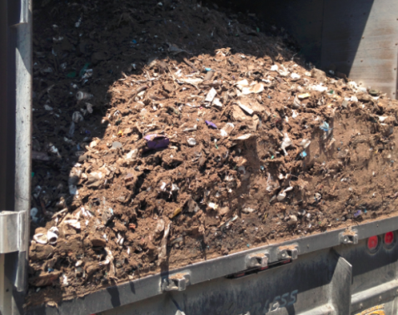
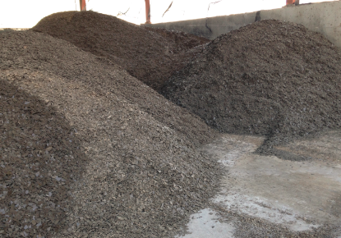



Different AF material types can influence the dosing performance
Feed rates (t/h) during 3h: mixed AF material and nylon recycling residue

Slide 29
AF impact on exhaust gas quantity and heat consumption
Arrows are schematic, not in real proportion
Realistic range of heat / flue gas increase: 0-15%
higher heat loss* (flue gas)
Fuel
Flue gas with AFR
combustion gas
Fuel
water, ash, false air
Fuel
standard
combustion gas
Fuel
Flue gas w/o AFR
Air
excess air
air
fluctuations: NCV, t/h (to avoid CO)
higher O2
air
air
Flue gas with AFR
50°C
raw meal
850°C
Heat losses after preheater
Effect in preheater: energy flows
Flue gas
Flue gas (higher T)
*higher heat loss
Flue gas

Slide 30
Impacts on heat consumption can be quantified the with FMO based on the LGF* Study
LGF*: Low grad fuel
Example:
30% TSR, average AF moisture 20%, no ash, NCV 18 GJ/t AF, STEC 3.4 GJ/t clinker, 1% additional O2 required to avoid CO.
Additional excess air (O₂): 0.018 * 3.4 = 0.061 GJ/t cli
Water: 0.3 * 3.4 / 18 * 0.2 = 0.011 t water/t cli → * 2.15 GJ/t water = 0.024 GJ/t cli
Total: 0.061 + 0.024 = 0.085 GJ/t cli = + 85 kJ/kg cli.
Influence factor | Impact on heat consumption
 | Unit | All kilns
Water | GJ/t H₂O | 2.15 (4.6)*
Ash | GJ/t ash | 1.1
Add. transp. air (false air) | GJ/kNm³ | 1.0 (0.7)**
Oxygen level | % q per % O₂ | 1.8***
Note: For proper application of above factors consult definitions/explanations in the LGF study
q: specific heat consumption [e.g. 3.2 GJ/t clinker]
* When when injecting pure water → 4.6 GJ/tH₂O
** 0.7 GJ/kNm³ applies for Wet kilns only
*** Oxygen increase after last addition of fuel.
Gas bypass (Cl) also increases heat consumption:
+ 10 MJ/t clinker per 1% bypass rate (calciner kiln)
+ 20 MJ/t clinker per 1% bypass rate (preheater kiln) Typical bypass rate: 5-10%

Slide 31
High AFR use increases specific heat consumption, correlating with solid AFR (example LD)

Slide 32


AF use may impact kiln production rate if exhaust gas handling capacity is a limited
bottleneck?
Flue gas with AFR
Flue gas
Filter size / efficiency
Main filter
Fan / motor capacity
Pump capacity, poor atomization
Raw mill
Conditioning Tower
Fan / motor capacity

Slide 33
Potential clinker production losses can also be quantified. Only applicable for sold-out markets.
Example:
30% TSR, average AF moisture 20%, no ash, NCV 18 GJ/t AF, STEC 3.4 GJ/t clinker, 4000 t cli/d, 1% additional O2 required to avoid CO.
Additional excess air (O₂): 0.057 * 4000 = 228 t cli/d
Water: 0.3 * 3.4 / 18 * 0.2 * 4000 = 45 t water/d → * 2.0 t cli/t water = 90 t cli/d
Total: 90 + 228 = 318 t cli/d (- 8% production rate)
Influence factor | Impact on kiln capacity tons lost - if exhaust gas system limited
 | Unit | PC/SP kiln | Grate PH | Long wet
Water | t cli / t H₂O | 2.0 | 1.6 | 0.8
Ash | t cli / t ash | 0.26 | 0.22 | 0.11
Add. transp. air (false air) | t cli / kNm³ | 0.24 | 0.2 | 0.07
Oxygen level | % cap per % O₂ | 5.7*** | 5*** | 4.4***
Note: For proper application of above factors consult definitions/explanations in the LGF study
SP: Suspension Preheater, PC: Precalciner Kiln
*** Oxygen increase after last addition of fuel, for more details see LGF study
No impact on kiln capacity if
Reserves in the gas handling system are available
The Gross OEE is low due to market reasons
Bottlenecks in gas handling system are addressed with process optimizations measures or kiln system modifications

Slide 34

AF impacts on emissions
Dust:
EP’s: slight increase (higher gas flows, VOC/Cl can reduce EP efficiency) EP trips due to CO (combustion not under control).
Normally no increase with bag filters
CO / VOC:
Can be avoided/alleviated when following rules: Stable dosing and NCV, sufficient O2, respect TSR limits for fuel type/feed-point and kiln specific constraints.
HCl/SO2:
Emissions practically not affected with preheater/calciner kilns
NOx:
Most AF reduce NOx formation (emission reduction) Lower NOx with worse combustion (typical AF). High content of volatile matter also reduces NOx (e.g. plastics).
SO2, NOx, HCl, (CO / VOC) emissions can significantly increase on kilns w/o intense mixing between flue gases and raw meal (Lepol, long wet/dry kilns). The same is valid for kilns with a gas bypass.

Slide 35
Heavy Metal (HM) emissions mainly depend on the input quantity - AFR can increase it
Non-volatile HM end up in the clinker or bypass dust, generally no emissions.
Semi-volatile HM accumulate in the main filter dust, partly emitted with dust (minor emissions) → discharge CKD to cement as a valve, improve dedusting.
Volatile HM only a small amount can be absorbed in the kiln dust (temperature dependent) and end up in the emissions → Minimize input (traditional and AFR), reduce filter temperature & discharge CKD.
As, Co, Cr, Cu, Mn, Ni, Pb, Sb, Sn, V, Zn
Hg
Cd, Tl, (Hg)
Others
Tl, Cd
(Tl), Hg

Slide 36
Problematic Fuel Properties (typically, compared to traditional fuel)
Coarser Granulometry
Higher moisture / water content
Often higher ash content (not liquids
Lower Calorific Value (consequence of high moisture and high ash)
Higher Chlorine concentration (Sulfur typically not an issue as concentration typically ≤ traditional fuels)
Less homogeneous (e.g. standard deviation of NCV, H2O, ash,…)
Less accurate dosing and more difficult material handling (consequence of coarse granulometry and high moisture)
Which property is most critical?
The one you do not address and mitigate appropriately!

Slide 37
Key messages
Fluctuations (NCV, t/h) have a big impact on combustion and heat consumption → accurate dosing is a must!
Cl input to kiln system is limited → Cl price tag for waste?!
Efficient cleaning required (air-blasters) with higher Cl input and coarser fuels.
With high TSR, water input and fluctuations an upgrade of the exhaust gas handling system could be required to avoid production loss in sold-out markets.
Raw mix review required with high ash inputs by AF.
Negative impact on emissions by AF can be largely avoided.

Slide 38
Content
AFR fuel categories and feed-points
Problematic AFR properties and kiln impacts
Optimizations / modifications to mitigate AFR impacts
Kiln
Precalciner/preheater
Exhaust gas handling system
Checklist for AFR assessment (co-processing focus) and main findings
Challenges and Solutions in kiln operation

Slide 39

Kiln: Optimizations / modifications to reduce heat consumption, exhaust gas flow and increase kiln availability
Vapour barrier against kiln shell corrosion
Optimization of Pre-Processing: shredding and air separation; handling & feeding (e.g. homogenization, screening, dosing, injection speed)
Optimization of O₂ control (e.g. reliable TA damper, well maintained kiln inlet probe & analyzer)
Bricks with low coating tendency
Burner Optimization/upgrade (e.g. PA volume and split, burner position, swirl air device)
Alkali resistant refractory qualities
Cooler Optimization/upgrade (e.g. bed height, air distribution, control)

Slide 40



“Satellite burner”: Experience in Höver and Lägerdorf
150 mm pipe, 0.8 m into kiln hood, ~40 m/s, 5-8 t/h
Fluff “dries” while flying trough the kiln hood - ignites when reaching main burner tip
Axial air (main burner) required to suck the fluff into flame
Shorter and more stable sinter/burning zone
Better sulfur incorporation in clinker, good C3S
Higher feed rates or less problems with lower quality fluff
More homogeneous flame (less double flame tendency)
Correct positioning is very important: adjusting of the satellite pipe required.

Slide 41


“Satellite burner”: Experience in Mannersdorf
Installed in Feb 2016, collaboration with Unitherm
Refractory + cooling air
Above MB, centered, 1.5m behind (MB is flush to kiln i.e. 0mm inside when cold)
Good results with 4 tph SSW and 1 tph petcoke
Build-ups on main burner disturb the SB

Slide 42


Kiln Shell Protection
Vapour barrier against steel shell corrosion
anticorrosive ceramic paint (corrosion protection)
stainless steel plates (avoid abrasion of ceramic paint)
low porous brick lining with mortar (e.g. Kronal 60, R2000,…)

Slide 43

Refractory concept for rotary kiln
Use of alkali resistant refractory qualities
Lower transition zone:
Magnesia spinel brick with low porosity (<15 %)
Magnesia zirconia spinel brick, where required
Upper transition zone:
Magnesia spinel brick with low porosity (< 15 %)
Calcining zone:
Fireclay brick
High alumina brick with SiC
Safety zone:
High alumina brick with SiC
Magnesia spinel brick with low porosity (< 15 %)
Sintering zone:
Magnesia spinel brick with low porosity (< 15 %)
Cooling zone:
- High alumina brick with SiC

Slide 44


Reliable signal from the kiln inlet gas analyzer and optimize combustion by using sufficient excess air!
Probe location is critical: Keep the part of the probe within the kiln inlet/riser as short as possible.
The following are recommended:
KilnLoq from FLS AirLoq
SCP 3000 from SICK
Cemtec from ENOTEC
SCK with type H probe from ABB
Operate the kiln with sufficient O2 (but not excessive).

Slide 45




Dispersion of Solid AFR by Swirl Air Device
Swirl air device should disperse the AFR better in the flame. → However, if too much air is used the AFR can shoot out of the flame and land on the clinker bed.
From all important suppliers: Unitherm, Pillard, KHD, FLS
Effect on combustion improvement often not measurable

Slide 46

Preheater: Optimizations / modifications to reduce heat consumption, exhaust gas flow and increase kiln availability
PC_{exit}/Ph_{exit} O₂ optimization (e.g. reliable PC_{exit}/PH_{exit} probe & analyzer )
False air reduction
Optimization (maintenance) of meal flaps, splash boxes and dip tubes
Alkali resistant refractory qualities
Cyclone upgrade or replacements (e.g. inlet modification, enlargement)
Gas-tight capsulated lining, Coating neutral refractory (SiC)
Enlargement of calciner volume (large gas retention time > 5s)
Efficient preheater cleaning
Turbulence generation by secondary orifice
Optimization of fuel feed points
Segmented Dip Tube (better cyclone efficiency / dust separation)
Optimization of Fuel Preparation & Feeding
Reduction of calciner orifice

Slide 47


Calciner Orifice Modification
Low cost solution to prevent dropout of AFR from calciner to kiln inlet
Reduction of orifice cross-section by increase of refractory thichness and/or shell modification
Requires also orifice in TA duct to maintain air balance kiln/calciner

Slide 48



Refractory concept for static part
Cornerstones of the Holcim Refractory Concept
Higher wall temperatures
no water or acid condensation on steel shell
Gas-tight capsulated lining
anchors and support flanges protected against the gases
Use of alkali resistant refractory qualities
no alkali infiltration or expansion

Slide 49



Combustion chamber for coarse solid AFR FLS HotDisc / Polysius Step Comubstor
Lägerdorf plant
Rohoznik plant

Slide 50





Precalciner Enlargement
Lägerdorf
Extension of Length: + 26 m
Increase in Volume: + 525 m³
Retention Time: + 1.5 sec to 5.1 sec
Eclepens
Increase of TSR and Production increase through conversion to Precalciner Technology
Production increase from 1700 to 2300 t/d

Slide 51
Exhaust gas handling: Optimizations / modifications to increase the capacity and availability
Water injection in top stage or downcomer
Baghouse enlargement Bag replacement
Protective coating / Selective use of high alloy steel (e.g. filter cages)
EP replacement by baghouse
False air reduction
Optimization gas conditioning
Upgrade or replacement of nozzles & pump
Fan & motor upgrade or replacement
On-line fan balancing

Slide 52
Key Messages
High kiln availability is a pre-requisite for high TSR!
Increase in heat consumption ≠ production loss, if the main bottlenecks of the kiln system are properly addressed
Definition of the required kiln optimization measures and required kiln modifications needs to be an integral part of
each Plant Master Plan
each AFR CAPEX Project
The Process Performance Engineer is the key person to master the challenges by AFR.

Slide 53
Content
AFR fuel categories and feed-points
Problematic AFR properties and kiln impacts
Optimizations / modifications to mitigate AFR impacts
Kiln
Precalciner/preheater
Exhaust gas handling system
Checklist for AFR assessment (co-processing focus) and main findings
Challenges and Solutions in kiln operation

Slide 54
Checklist for technical AFR assessment (co-processing focus)
Heat and mass balance
Burner check, kiln shell scanner (coating profile)
Precalciner/Preheater
Preheater assessment (Preheater Tool), p and T profile, false air
Installed air blasters (working?), cleaning/CARDOX ports → cleaning routine
Precalciner gas residence time and orifice velocity
AFR feed-points
Tertiary air damper (working? used?)
Cooler
Efficiency, air distribution and compartment pressure profile
Gas analyzers
CO vs O2 at kiln inlet and PH(PC) exit
Trends of CO, O2 and NOx
Location, availability
Gas handling capacity: ID fan and filter fan reserves (speed, kW, p) in direct/compound operation
TF and AF blending and dosing accuracy. Kiln feed dosing accuracy

Slide 55
Checklist for technical AFR assessment (cont.)
Main control loops
PC temperature, cooler undergrate pressure/grate speed, kiln hood pressure, fuel compensations AF vs. TF, Bypass operation, water injection (T after cond. tower)
Daily clinker production for last year
Kiln stop and down-time pareto (process related stops)
Main process parameters in periods with highest TSR
Quality parameters
Traditional fuel fineness control
Kilnfeed and clinker uniformity (LS, SR, AR, freelime)
Fuel properties (average and fluctuations)
Chlorine input from raw materials
Hotmeal analyses and frequency
Clinker appearance (granulometry, density, color)
Kiln dust extraction and handling/dosing
A/S/Cl-Balance
AFR permits, PEP

Slide 56
Many causes limiting co-processing capacity are general deficiencies in kiln operation (not directly related to AFR)
Inadequate/inaccurate traditional fuel preparation and dosing
Pre-blending of different coals, petcoke and charcoal.
Uncontrolled fuel fineness (also sampling) and dosing fluctuations. On-line calibration not working (off-set between present value and set-point).
Inefficient Combustion
Minimum O2 levels are not respected.
Low availability or not trustworthy signal and of kiln inlet analyzer.
Tertiary air damper not working (not adjustable anymore).
Main kiln control loops are not well-tuned
PC temperature, cooler undergrate pressure and grate speed, kiln hood pressure, ID fan speed.
Kiln operation fluctuations: coal mill on/off, raw mill on/off (water injection in conditioning tower)
False air !!!
Insufficient exhaust gas handling capacity: ID fan, filter fan
Low kiln availability: many unplanned stops (MTBF)

Slide 57
Dosing fluctuations of solid AF is often the major limiting factor to increase TSR
AF dosing fluctuations
Feed starvations (detection of blockages → cameras), only volumetric dosing, bad feed rate controller.
Not adequate AF preparation
Inhomogeneous blend (NCV fluctuation), oversize material causing blockages (shredding, screening).
No agreement of AF properties between Geocycle and plant. No acceptance criteria for direct deliveries.
Inefficient Combustion
O2 levels are not adjusted (increased) when using AF.
Precalciner orifice design not correct (coarse AF fall-through to kiln inlet).
Surpassing of kiln system combustion limits for certain feed-points
Excessive TSR at kiln inlet. Too fine material fed to kiln inlet/riser duct (combustion in cyclone).
Small precalciner (low residence time not sufficient for complete combustion).
Incorrect traditional fuel compensation
Too slow, too extreme or not enough compensation in case of AF feed rate changes or failures.
High Cl inputs
Inefficient and inadequate cleaning as build-up situation becomes more critical
Low hotmeal sampling frequency and no clear instruction what to do if SO3 and Cl surpass critical levels.
Not sufficient air blasters (not working air blasters).
Insufficient exhaust gas handling capacity: ID fan, filter fan
Poor kiln feed and clinker uniformity (e.g. free lime, C3S, LSF fluctuations)
Additional fluctuation by AF ash input prevents increasing feed rates
High ash input by AF may require increase use of high grade limestone that is costly

Slide 58
Content
AFR fuel categories and feed-points
Problematic AFR properties and kiln impacts
Optimizations / modifications to mitigate AFR impacts
Kiln
Precalciner/preheater
Exhaust gas handling system
Checklist for AFR assessment (co-processing focus) and main findings
Challenges and Solutions in kiln operation

Slide 59
Kiln operation challenges and solutions
Slower reacting kiln
Variable fuel properties and heat input
Ambiguous (unclear) burning zone temperature signals
Opposed optimization targets for O2 and kiln inlet temperature
Well trained operators
Adequate instrumentation and actuators
Proper target setting
Proper operation strategy

Slide 60

Slow reacting kiln
Causes
Less powerful flame
Reduced emissivity due to lower flame temperature (low NCV, delayed ignition and burnout of fuels)
Increased absorption of flame radiation due to higher dust load of secondary air due to finer clinker granulometry (higher S input, reducing conditions)
Higher inertia of kiln
Higher material load in the kiln due to longer burning zone and less efficient transport of finer clinker in kiln (impaired rolling movement of clinker bed)
Positive effects:
Reduced emissivity = Lower NOx production lower costs for SNCR.
Higher material load = More difficult to cool down kiln! But also more difficult to warm up…

Slide 61
Well trained operator play a key role in reducing delayed interventions
Train operators on a regular basis in general process know-how and in kiln operation with AFR (HTEC workforce training, kiln simulator, etc.)
Encourage operators towards “proactive” kiln control
Give freedom to the well trained operators
Well trained operators shouldn’t be forced via telephone to modify their strategy
Evaluate systematically and honestly operators. Use evaluation during the dialogue.

Slide 62
Variable fuel properties and heat input
Variable heat input from fuels
Temperature and CO peaks in kiln and calciner, due to fluctuating fuel mass flow and calorific value (especially from AFR)
Variable flame geometry
Lengthening / shortening of flame due to variable burnout behavior of fuels and different reaction kinetics
More frequent ring and coating collapse
Less stable coating situation due to shifting temperature profile in kiln → moving of kiln shell cooling fans to avoid hot areas

Slide 63
Ambiguous BZT signals
Sintering zone, further up and changing
More frequent coating falls
Dustier kiln atmosphere
Variable fuel mix (CV, granulometry, etc.)
Impact
Pyrometer reading
NOx
Kiln torque

Slide 64
Proper operation strategy is required
1. Keep the fuel mix stable
The best TSR is achievable with sustainable fuel rate
AFR off as first reaction is the wrong approach!
2. Compensate AFR fluctuations (compared to setpoint) in the control system with master fuel. Where and when to compensate AF at kiln inlet?
Preconditions:
The NCV is known (at the time of burning)
Dosing system is working correctly
Additional help: Visual inspection
Cameras to check what really is going in the kiln
Cameras to supervise manual mixing / feeding

Slide 65


Manual AFR feeding: Impact on kiln?
link
shift change
SLC temp PV
SLC temp SP
coal

Slide 66
Correct fuel compensation at main firing / precalciner
Compensate fuels gradually to smoothen impact of different flame lengths on BZT, to avoid overshooting of burning zone and CO peaks

Slide 67
Correct fuel compensation at kiln inlet (secondary firing)
Correct fuel compensation at secondary firing (e.g. tyres)
PH kiln: Compensate fuels gradually to avoid overheating of kiln or lack of oxygen in the kiln
PC kiln: Compensate big proportion immediately in precalciner firing

Slide 68

Reliable main instrumentation required on a kiln
Actuators
O2, CO
Sensors
Fuel rate
Fuel rate
Flap position
Fan speed(s)
Pyro
Grate speed(s)
Torque
Temp
Fan speeds
O2, CO, NOx
Feed rate
Pressure
Flow
Kiln speed

Slide 69
Opposed optimization targets for O₂ and kiln inlet temperature
High oxygen levels at kiln inlet (“required”)
Increased draft, required to compensate fluctuations of heat input and to maintain sulfur volatility low, increases kiln inlet T
Low kiln inlet temperature (“desired”)
Shifting condensation area of volatile compounds from static part into rotary part of kiln system and reduced risk of cyclone blockages, demands moderate oxygen levels in kiln

Slide 70
Proper target setting
Burning zone temperature
Define beside MAX also MIN free lime levels (soft clinker burning)
Kiln speed / kiln feed ratio
Adjust kiln filling degree towards lower levels, if clinker is fine (to guarantee rolling of bed and granulation of nodules) or if kiln reaction is sluggish
Oxygen
Define and maintain sufficiently high oxygen levels in the system, optimizing set-point via SO3 in hot meal and no (low) CO
Granulometry
Review (and adjust) kiln feed properties to guarantee a appropriate granulation of clinker (AR, liquid phase, fineness, A/S ratio, etc.)

Slide 71
Proper target setting
PC with AF as control fuel (~100% TSR in PC)
Select as control fuel the fastest reacting AF available
It should be as stable as possible in composition and size
PID loop parameters should be adjusted to cope with slow burning fuels
AF at Kiln Inlet
At high TSR with lumpy fuels, O2 stability at PH exit shouldn’t be pursued as before
Fuel compensation must be done in PC.

Slide 72


High Level Control system can smooth kiln operation
Kiln Master offers:
Optimization of set-points
Reduction of fluctuation of main process parameters
Build-up of local knowledge
Easy to maintain by local personnel
Best achievements in PC kilns, further development ongoing in HTEC
Oxygen control in Kiln Master
Fuel Compensation in KM

Slide 73
Key messages
An optimized and well controlled kiln is a precondition for successful AFR utilization. Good instrumentation is key to know what is going on in the kiln system.
AFR are usually not the main challenges of kiln operation if:
Properly prepared (NCV fluctuations)
Known what is burned at the time of burning
Dosed properly / reliably
Train operators and give them time to operate the equipment
Regular follow up of operator actions is required.

